Slide 1
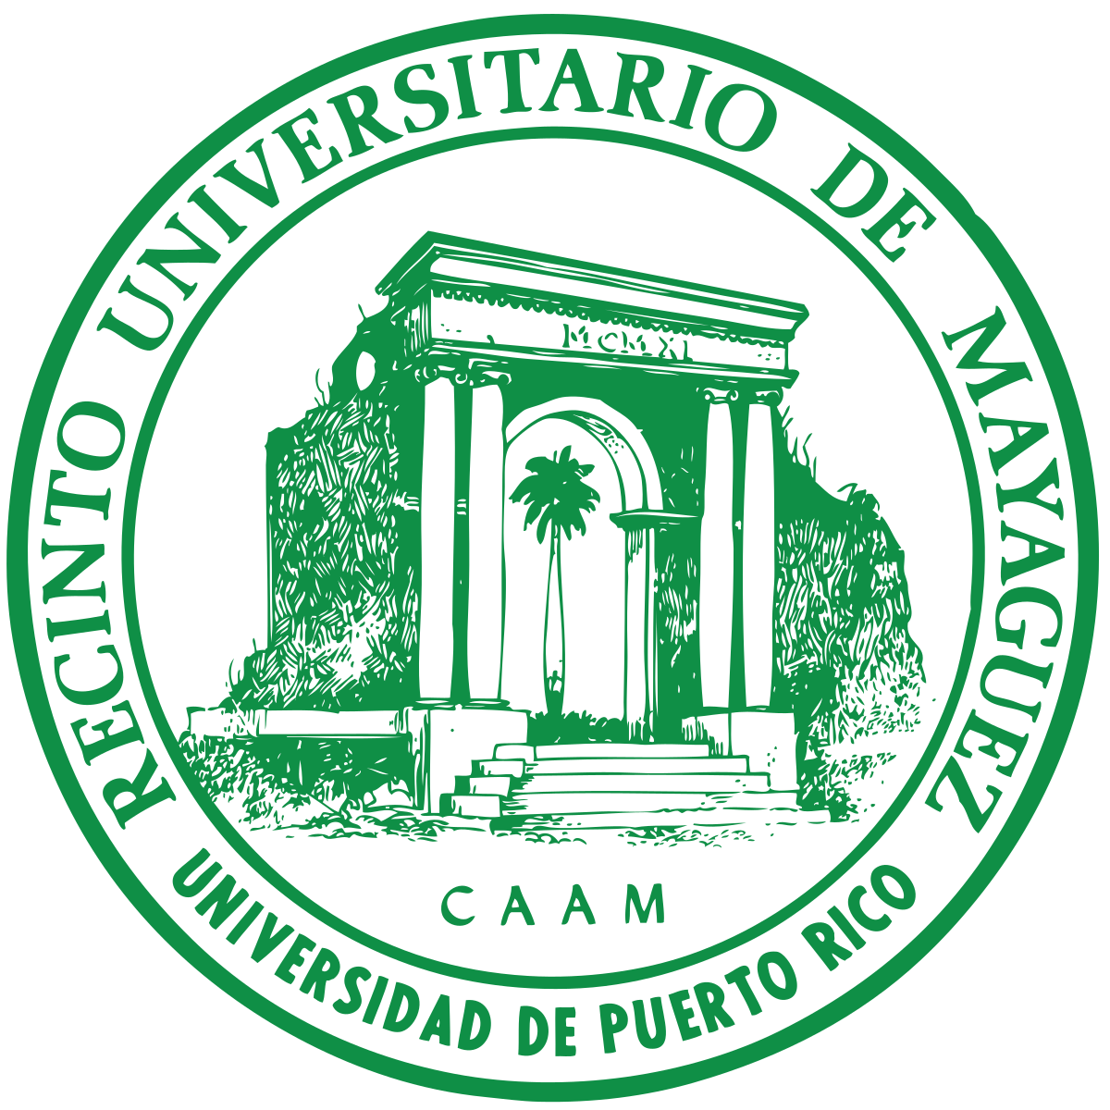

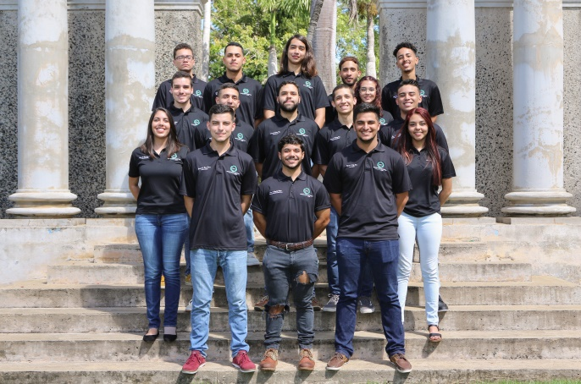
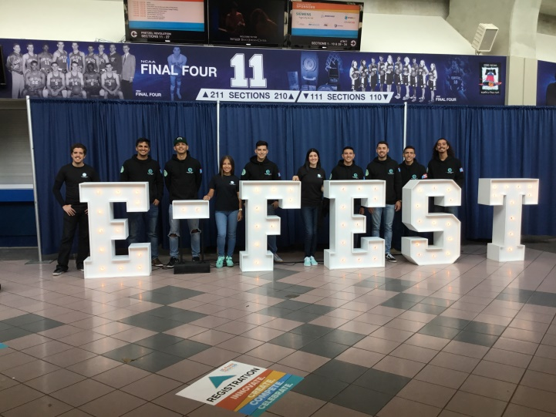
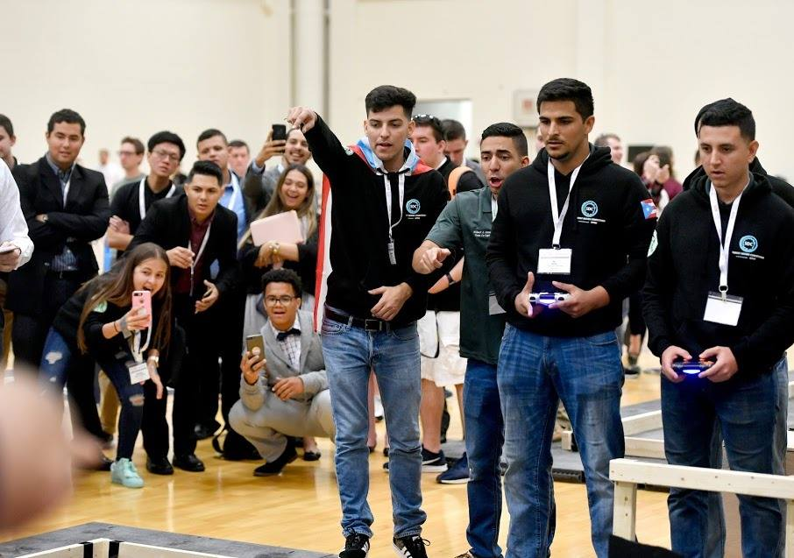





Student Design Competition UPRM
Group Logo
Advisor: Dr. Eduardo Ortiz
1. Introduction
5. Results
The Student Design Competition (SDC) Team of the UPRM is a team of university students of different concentrations that strive to represent the University of Puerto Rico in the annual robotics competition of the American Association of Mechanical Engineers.
They are also a congregation of some great minds with the mission of inspiring other students to keep growing as they continue their paths to success.
Official group photo of the members of the 2018-2019 team
In 2017-18 the team had the opportunity to travel to Pennsylvania to compete at Penn State University where we finished 15 out of 54 universities.
The members of the 2017-2018 team had the opportunity of participating on the ASME E-Fest held at Michigan State University.
Here is the trajectory of the team from the 2 years it has been active.
Student Design Competition Team Trajectory
Year | Place of Competition | Rank
2017-18 | Penn State University | 15 out of 54
2018-19 | Michigan State University | ?
2. The Student Design Competition
Where they competed on the Student Design Competition and ranked 15 out 54 universities.
In 2018-19 the team has the mission of traveling to Michigan to compete at Michigan State University where we will, again, represent the University and get a chance at the top rank.
There are a total of 19 members, 8 from Mechanical Engineering, 4 from Electrical Engineering, 3 from Computer Engineering, 3 from Industrial Engineering and 1 from Marketing.
The ASME Student Design Competition (SDC) provides a platform for ASME Student Members to present their solutions to a range of design problems - from everyday household tasks to groundbreaking space exploration. Each team is required to design, construct and operate a prototype meeting the requirements of an annually determined problem statement.
Student Design Competitions will be held at ASME’s global E-Fests (Engineering Festivals). E-Fests are a three-day, two-night regional event built around design, advanced manufacturing and robotics technologies. They enable engineering students to expand their knowledge, test and showcase new skills and inspire innovation.
4. Methodology
The work dynamic in the project is divided in four stages: brainstorming, designing, manufacturing, and testing. Each year the SDC competition releases a new challenge. The project begins once the challenge is announced with the brainstorming stage. Where the team has to analyze different methods to obtain and guide the pathway to the final prototype. Following the first stage is the design stage, it is encouraged that the team works on at least two approaches for the design of the robot. This ensures confidence and flexibility in the final product. After obtaining the results of the design stage, the team analyzes the design in computer software’s to ensure its reliability. Once the final design is created the team will start the following stage of the project. The manufacturing stage consists of fabricating, ordering and assemble all the components in the design to generate the final product. To complete the project the final product is tested to ensure reliability and repeatability in the robot's performance. Given that a challenge arises the team will proceed to optimize the product and re-test it until an optimal final version is achieved.
6. Timeline
Brainstorming
Manufacturing
Competition
Testing
Design
Optimization
Follow us on:
3. Objectives
Develop students as professionals.
Expose students to real life, problem solving, scenarios.
Get students to do interdisciplinary work.
Uniting students by using the project to help them with their teamwork in skills.
Represent the University in the Competition.
SDC UPRM
Become part of our team
Our equal opportunities approach means that everyone can become part of our team, build their expertise and expand their skill set. Are you ready to apply to SDCUPRM? The next step is sending your resume via e-mail to sdcuprm@gmail.com. If you are selected, you will be contacted for an interview.

